Slide 1

Documenting Our Work Surveys:
2020 Updates
VAdata: Virginia’s Sexual and Domestic Violence Data Collection System
Notes:
Presented & last updated 07/16/20.

Slide 2
What is Documenting Our Work?
A national initiative, the Documenting Our Work (DOW) project was initiated by Family Violence Prevention and Services Act (FVPSA) staff and the National Resource Center on Domestic Violence (NRCDV) in the late 1990s.
DOW surveys collect outcome data directly from survivors on the impact and value of services provided by local domestic violence programs.
Please review VAdata Training Module 5: Documenting Our Work on VA for more details.

Slide 3
How do we participate in Virginia?
In Virginia, two surveys collect feedback from people receiving shelter services and community-based services.
These surveys collect information about the outcomes of working with agencies in two general settings; they do not evaluate specific services offered by an agency.
Both surveys were last updated in 2014 and are available in English, Amharic, Arabic, Chinese, Dari, French, Korean, Pashto, Spanish, Tigrinya, and Vietnamese.
Starting July 2020, English and Spanish surveys will also be available to complete online.

Slide 4
How do the online forms work?
The Action Alliance maintains DOW surveys in Qualtrics.
Each agency receives unique URLs (web addresses) to collect feedback from their clients. For now, each agency will receive 4 URLs (Community-Based Survey & Shelter Survey, each in English & Spanish).
SDVA staff provide clients with either safe internet access on an unmonitored device at the agency/shelter, or instructions for safe access on their own. (We’ll talk about this more later!)

Slide 5
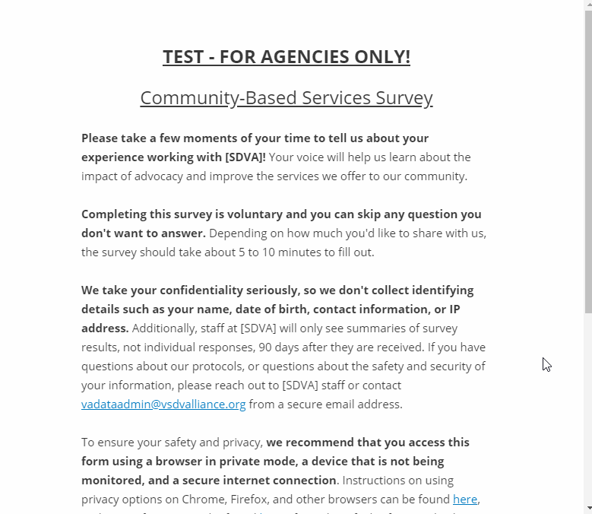
A preview of the online form

Slide 6
How can clients access online DOW surveys safely?
Keep in mind, confidentiality should not be compromised in any situation!
When possible, we recommend that clients use agency devices and internet access to access the surveys. We expect this is more likely to be possible in the context of shelter and support groups (when meeting in person).
If you explain the risks of using personal devices and personally-managed internet access and the client wishes to continue using their own tools, respect that choice – survivors know their risks better than anyone.

Slide 7
How can clients access online
DOW surveys safely? (continued)
The form should be accessed:
  using a browser in private mode,
  on a device that is secure (not being monitored), and
  on a secure network
Safety measures should be discussed with clients prior to sending them the URL. If emailed, make sure the link is sent to a secure email address.
If client doesn't feel safe enough to complete the survey, or if they suspect that someone may be monitoring their device and/or internet use, then they should talk to an advocate about their safety. The survey can wait!

Slide 8
Where can I learn more about safety planning with technology?
The Safety Net Project from NNEDV
  https://www.techsafety.org/safe-contact-methods
  https://www.techsafety.org/resources-agencyuse/email-bestpractices
  https://www.techsafety.org/wifi-safety-privacy-tips-for-survivors
  https://www.techsafety.org/resources-agencyuse/shelter-computers-bestpractices
  https://www.techsafety.org/12tipscellphones
Reach out to the Action Alliance!
  The Data Systems and Evaluation team (Tamara, Kristin, and Amanda) can answer questions and provide technical assistance.
  The Training Institute also has trainings that may be coordinated virtually.

Slide 9
How Do Agencies Access Survey Data from the Online Forms?
At regular intervals, data from each form is downloaded as a CSV file and uploaded to VAdata.
Just like with paper surveys, there is a time lapse to protect the privacy and confidentiality of responses. Agencies will have 90 days from the day surveys are submitted before they can access summary DOW data through their VAdata reports.

Slide 10
When/How Do We Invite Clients to Complete Surveys?
Your agency’s data collection plan shouldn’t change much. The main difference is that clients now have an additional method by which they can complete DOW surveys. The following recommendations still apply:
  Community-Based Services: Invite each adult who receives services from your agency to fill out a survey on at least 3 different dates, several weeks apart.
  Shelter Services: Invite residents to complete a survey at the point that you think they are about mid-way through their shelter stay and/or at the end of their stay.

Slide 11
Do All Clients Have to Use the
Online Forms?
No, the online forms are just one way to fill out DOW surveys. Offering clients the opportunity to provide feedback is what matters most.
If people are more comfortable with paper forms, or it isn’t safe to access the online survey, they are welcome to continue to use paper forms.
Clients can also answer questions by phone, if it is safe to communicate and the client is surveyed by someone at the agency who did not directly provide services to them. The person surveying the client can enter answers in the online form or fill out a paper survey.

Slide 12
What About Languages Other Than
English or Spanish?
We are finalizing online forms for DOW surveys in Amharic, Arabic, Chinese, Dari, French, Korean, Pashto, Tigrinya, and Vietnamese. Stay tuned -- we hope to have them available soon!
Please continue to use paper forms or offer clients the option to answer survey questions over the phone.
If you have translation experience in any of these languages and would be interested in helping us, please reach out to Kristin at kvamenta@vsdvalliance.org.

Slide 13
Who do I contact for Questions About DOWs?
Kristin Vamenta
Evaluation and Technology Safety Director
kvamenta@vsdvalliance.org
804.377.0335
Itzel Patiño
Housing and Advocacy Coordinator
ipatino@vsdvalliance.org
804.377.0335

Slide 14
HELP! VAdata’s not working.
If you think something is wrong with VAdata, please let us know! Give us a call at 804.377.0335 OR email us at vadataadmin@vsdvalliance.org.
We don’t use VAdata in the same ways you do, so sometimes the only way that we know something is off or broken is when you tell us.
We also like to talk with you by phone when you have questions, because we usually want information that you might not know we need.

Slide 15
How Can I Get Additional Help About Other Topics or Concerns?
The Action Alliance staff urge you to contact us whenever you have a question or a concern about VAdata, resources, advocacy, policy, training, funding, or anything else.
Staff can be reached at
804.377.0335
Or you can visit our website to send a message directly to staff members. Visit https://vsdvalliance.org/contact/.

